Slide 1
Orthographic VIEWS

Slide 2
Orthographic Projections
Orthographic Projections is a technical drawing in which different views of an object are projected on different reference planes observing perpendicular to respective reference plane.
Different reference planes are:
Horizontal Plane (HP)
Vertical Plane (VP)
Side or Profile Plane (PP)
Different views are:
Front View (FV) – Projected on VP
Top View (TV) – Projected on HP
Side View (SV) – Projected on PP

Slide 3
NOTATIONS
Following notations are followed while naming
different views in orthographic projections:
OBJECT POINT A LINE AB
IT’S TOP VIEW a a b
IT’S FRONT VIEW a´ a´ b´
IT’S SIDE VIEW a´´ a´´ b´´
Same system of notations should be followed
in case numbers, like 1, 2, 3 – are used.
TERMS ‘ABOVE’ & ‘BELOW’ WITH RESPECT TO H.P.
AND TERMS ‘IN FRONT’ & ‘BEHIND’ WITH RESPECT TO V.P.

Slide 4
Types of views
Projections
Parallel
Converge
Orthogonal
Oblique
Multiview
Axonometric
Multi-view drawing
Pictorial drawing
Perspective drawing

Slide 5

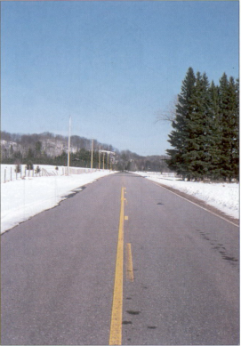
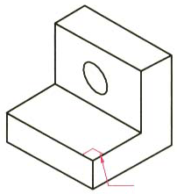
View comparison
Type
Advantage
Disadvantage
Multi-view drawing
Accurately presents object’s details, i.e.
size and shape.
Require training
for visualization.
Right Side View
Front View
Top View
Pictorial drawing
Easy to visualize.
Shape and angle distortion
Circular hole becomes ellipse
Right angle becomes obtuse angle.
Perspective drawing
Object looks more like what our eyes
perceive.
Difficult to create
Size and shape distortion
Distorted
width

Slide 6
PLANES
PRINCIPAL PLANES
HP AND VP
AUXILIARY PLANES
Auxiliary Vertical Plane
(A.V.P.)
Auxiliary Inclined Plane
(A.I.P.)
Profile Plane
( P.P.)

A.V.P.
A.I.P.
⊥ to Hp & ∠ to Vp
⊥ to Vp
&
∠ to Hp


Slide 7
PATTERN OF PLANES & VIEWS (First Angle Method)
THIS IS A PICTORIAL SET-UP OF ALL THREE PLANES.
ARROW DIRECTION IS A NORMAL WAY OF OBSERVING THE OBJECT.
BUT IN THIS DIRECTION ONLY VP AND A VIEW ON IT (FV) CAN BE SEEN.
THE OTHER PLANES AND VIEWS ON THOSE CAN NOT BE SEEN.
Y
PROCEDURE TO SOLVE ABOVE PROBLEM:-
TO MAKE THOSE PLANES ALSO VISIBLE FROM THE ARROW DIRECTION,
A) HP IS ROTATED 90⁰ DOWNWARD
B) PP, 90⁰ IN RIGHT SIDE DIRECTION.
THIS WAY BOTH PLANES ARE BROUGHT IN THE SAME PLANE CONTAINING VP.
X
Y
VP
PP
FV
LSV
X
Y
X
TV
HP
ACTUAL PATTERN OF PLANES & VIEWS
OF ORTHOGRAPHIC PROJECTIONS
DRAWN IN
FIRST ANGLE METHOD OF PROJECTIONS
HP IS ROTATED DOWNWARD 90⁰
AND
BROUGHT IN THE PLANE OF VP.
PP IS ROTATED IN RIGHT SIDE 90⁰
AND
BROUGHT IN THE PLANE OF VP.

Slide 8

Projection systems
1. First angle system
- European countries - ISO standard
First
quadrant
2. Third angle system
- Canada, USA, Japan, Thailand
Transparent
planes
Opaque
planes
Third
quadrant

Slide 9

Orthographic views
1st angle system
(Opaque planes)
3rd angle system
(transparent planes/glass box)

Slide 10
Orthographic views
1st angle system
3rd angle system
Folding
line

Folding
line
Folding
line

Folding
line

Slide 11
Views arrangement
1st angle system
3rd angle system
Top View
Right Side View
Front View
Front View
Right Side View
Top View

Slide 12
Projection symbols
1st angle system
3rd angle system
d
1.7d
2.2d

Slide 13
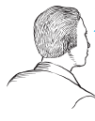
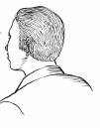
Methods of Orthogonal Projection
1. Natural Method: Revolve the object with respect to observer
2. Glass box method: The observer moves around the object.
Glass box concept
Top view
Top view
Front
view
Right side
view
Front view
Right side view
play
play

Slide 14
Glass box : Revolution of the planes of projection
Rear view
Left side view
Bottom view

Slide 15
Relative orientation of views
Top view
Depth
Front view
Width
Height
Rear view
Left side view
Right side view
Bottom view

Slide 16
Summary : Problem solving steps
Given
1
2
3
4

Slide 17


Steps for Orthographic Views
152
1. Select the necessary views
64
Top
25~40
2. Layout the selected views on a drawing sheet.
45
Front
152
Choose a drawing scale
(say 1:1)
3. Complete each selected views.
x
x
y
z
Top
4. Complete the
dimensions and notes.
y
x
x
Front
y
y

Slide 18
Procedures for View Selection
1. Orient the object to the best position relative to a glass box.
2. Select the front view.
3. Select adjacent views.

Slide 19
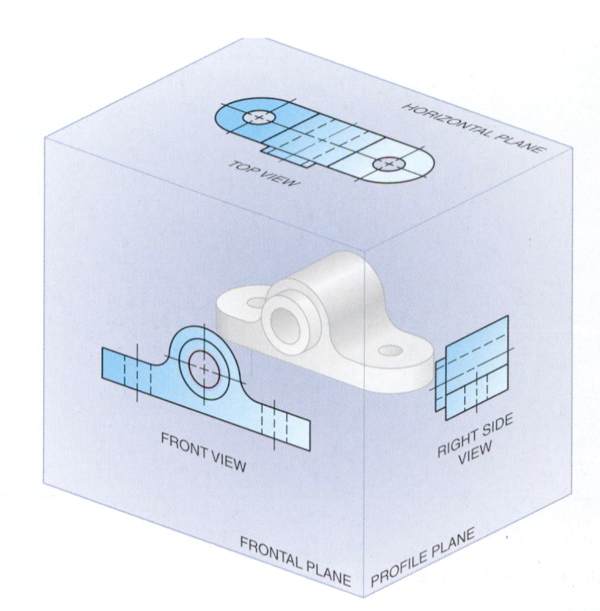
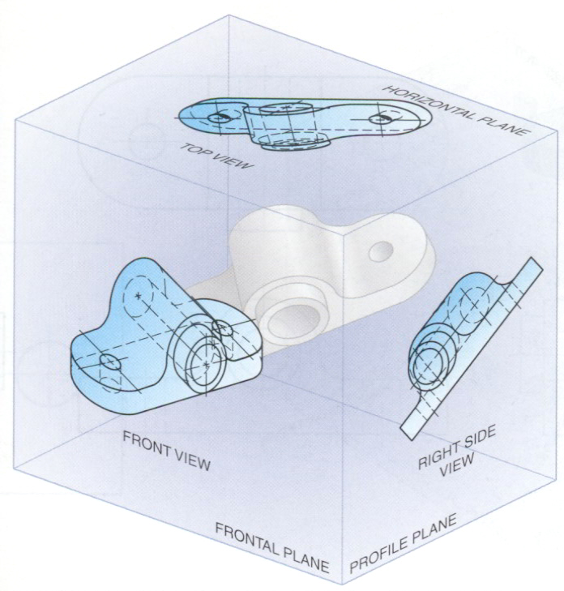
Suggestions: Orient the object
1. The object should be placed in its natural position.
2. The orthographic views should represent the true size and true shape of an object (as much as possible).
GOOD
NO !

Slide 20
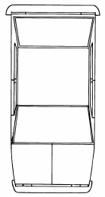
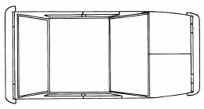
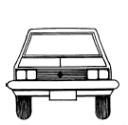
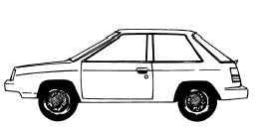
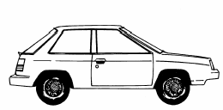

Suggestions: Select the front view
1. The longest dimension of an object should be presented as a width (in a front view).
First choice
Inappropriate
Second choice
Good
Use more space

Slide 21
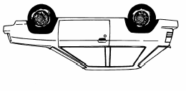
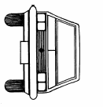
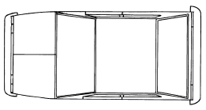
Suggestions: Select the front view
2. The adjacent views project from the selected front view should be appeared in a natural position.
Inappropriate

Slide 22

Suggestions: Select the front view
3. It has the fewest number of hidden lines.
Good
Inappropriate

Slide 23
Suggestions: Select an adjacent view
1. Choose the view that has the fewest number of hidden lines.
Inappropriate
Inappropriate

Slide 24
Suggestions: Select an adjacent view
2. Choose the minimum number of views that can represent the major features of the object.
All information is placed
on a single view.
Necessary
Hole’s information is placed on a separated view.
Necessary

Slide 25
Suggestions: Select an adjacent view
3. Choose the views that are suitable to a drawing sheet.
Poor
Not enough space
for dimensioning.
Choose another adjacent view.
Good
Change orientation of the
selected views.
Good

Slide 26
Summary
View selection has 3 steps
Orient
the object
Select
front view
Select
adjacent views

Slide 27
Object that requires only one-view
Flat (thin) part having a uniform thickness such as a gasket, sheet metal etc.
Cylindrical-shaped part.
Example
1 Thick
Adjacent views provide only a
part’s thickness !

Slide 28
Object that requires only one-view
Flat (thin) part having a uniform thickness such as a gasket, sheet metal etc.
Cylindrical-shaped part.
Example
Example
Repeat !
Infer from CL

Slide 29
Object that requires only two-view
Identical adjacent view exists.
The 3rd view has no significant contours of the object.
(provides no additional information)
Example
Repeat !

Slide 30
Object that requires only two-view
Identical view exists.
The 3rd view has no significant contours of the object.
(provides no additional information)
Example 1

Slide 31
Object that requires only two-view
Identical view exists.
The 3rd view has no significant contours of the object.
(provides no additional information)
Example 2

Slide 32
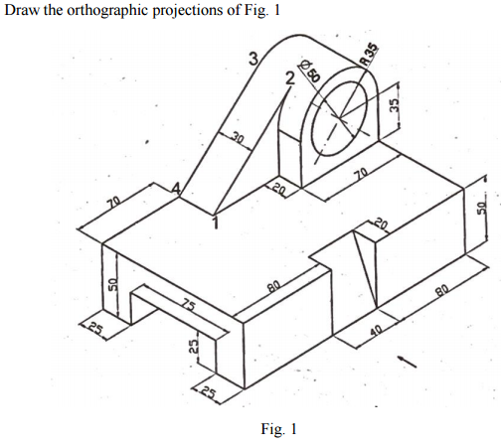
Example
Steps to draw projections
Identify surfaces perpendicular or inclined to the view
Surfaces parallel to the view would not be visible in that view.
First draw horizontal and vertical reference planes (easily identifiable on drawing)
Start drawing from the reference planes.

Slide 33
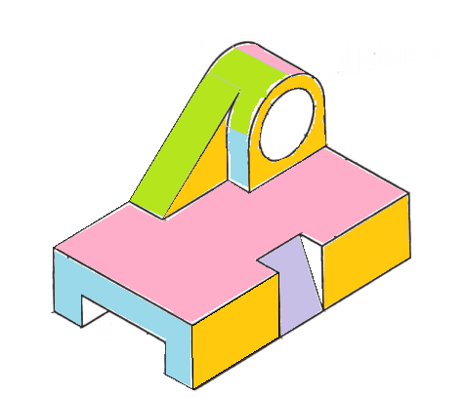
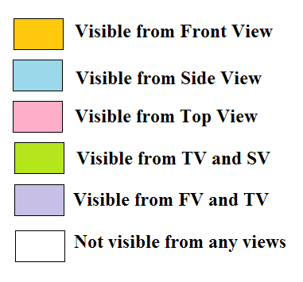
Vertical reference plane (VP)
Top view
Horizontal reference plane (HP)
Side view
Front view

Slide 34
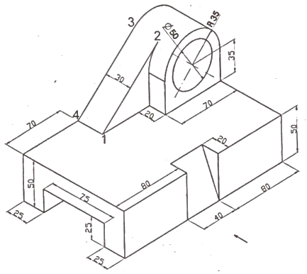
Midpoint
35
Φ 50
70
50
HP
80+40+80=200
Front view
Side view
70
30+20=50
20
80
40
VP
Top view

Slide 35
+
70
Φ 50
50
25
200
25
125
Front view
Side view
70
50
20
40
80
20
80
Top view

Slide 36
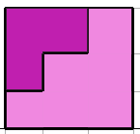
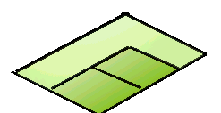
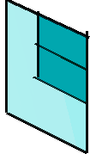
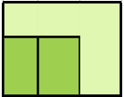
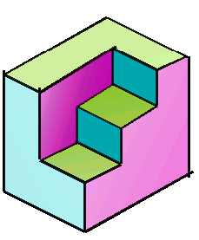
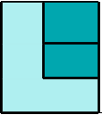

FOR T.V.
S.V.
F.V.
Example
ORTHOGRAPHIC PROJECTIONS
FRONT VIEW
L.H.SIDE VIEW
FOR F.V.
FOR S.V.
x
y
PICTORIAL PRESENTATION IS GIVEN
DRAW THREE VIEWS OF THIS OBJECT
BY FIRST ANGLE PROJECTION METHOD
TOP VIEW

Slide 37
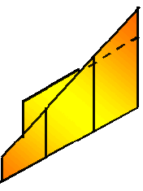

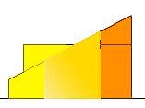

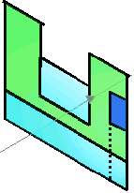
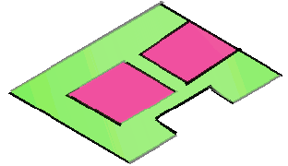

FOR T.V.
Example
S.V.
F.V.
ORTHOGRAPHIC PROJECTIONS
FRONT VIEW
L.H.SIDE VIEW
X
Y
FOR S.V.
FOR F.V.
TOP VIEW
PICTORIAL PRESENTATION IS GIVEN
DRAW THREE VIEWS OF THIS OBJECT
BY FIRST ANGLE PROJECTION METHOD

Slide 38
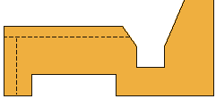
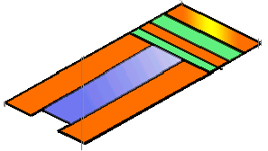

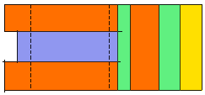
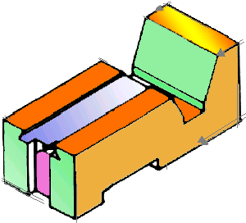
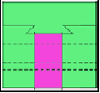
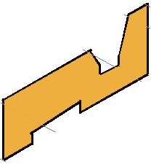
FOR T.V.
Example
S.V.
F.V.
ORTHOGRAPHIC PROJECTIONS
FRONT VIEW
L.H.SIDE VIEW
FOR F.V.
FOR S.V.
X
Y
PICTORIAL PRESENTATION IS GIVEN
DRAW THREE VIEWS OF THIS OBJECT
BY FIRST ANGLE PROJECTION METHOD
TOP VIEW

Slide 39
Example
FOR T.V.
ORTHOGRAPHIC PROJECTIONS
35
FV
35
x
10
y
10
20
30
FOR F.V.
40
70
TV
O
PICTORIAL PRESENTATION IS GIVEN
DRAW FV AND TV OF THIS OBJECT
BY FIRST ANGLE PROJECTION METHOD

Slide 40
FOR T.V.
Example
ORTHOGRAPHIC PROJECTIONS
45⁰
30
FV
40
X
Y
30 D
FOR F.V.
40
TV
O
PICTORIAL PRESENTATION IS GIVEN
DRAW FV AND TV OF THIS OBJECT
BY FIRST ANGLE PROJECTION METHOD
15
40

Slide 41
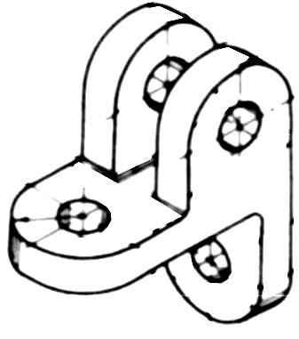
FOR T.V.
Example
ORTHOGRAPHIC PROJECTIONS
FRONT VIEW
L.H.SIDE VIEW
X
Y
FOR F.V.
FOR S.V.
TOP VIEW
PICTORIAL PRESENTATION IS GIVEN
DRAW THREE VIEWS OF THIS OBJECT
BY FIRST ANGLE PROJECTION METHOD

